Slide 1

Why Is There So Much Pain & Suffering?

Slide 2

2 Corinthians 12:7-10
Pain & Suffering – The Issues
The Atheist View of History & God
The Biblical View of History & God
The Role of Man’s Free Will

Slide 3
2 Corinthians 12:7-10
The Nature of Death and Suffering
God’s Purposes In Our Suffering
What Is God Doing About It?
Our Source of Hope

Slide 4

Pain & Suffering – The Issues

Slide 5
Genesis 3:17; Genesis 50:20; Psalms 40:12
Death & suffering everywhere
— Natural disasters, disease, manmade
What is the source of evil?
Biblical examples of suffering

Slide 6
Genesis 3:17; Genesis 50:20; Psalms 40:12
How the world deals with it:
— Darwin — death of daughter,
— Ted Turner – death of sister
Atheist’s case dismissed – a moral law implies a moral law giver
Mother Teresa’s actions better than Hitler’s?

Slide 7

Atheist’s View of History & God

Slide 8
Romans 3:23, Revelation 21:4
Evolution requires death
“The secrets of evolution are time and death”, Carl Sagan
Death, disease, suffering is a permanent part of history

Slide 9
Romans 3:23, Revelation 21:4
Death is ‘our ally’ in the creation of life by evolution
Atheists have the wrong view

Slide 10

Biblical View of History & God

Slide 11
Gen. 1:31; Gen. 2:17; 1 Cor. 15:26; Rom. 5:12; Acts 3:21
God saw that it was good
Adam’s rebellion brought sin and death (as a result)
Death is an enemy, not an ally
Sin entered through one man

Slide 12
Gen. 1:31; Gen. 2:17; 1 Cor. 15:26; Rom. 5:12; Acts 3:21
God is holy and just
— Penalty for sin necessary
Temporary taste of life without God
The world will be restored
Correct view of history and God

Slide 13

Role of Man’s Free Will

Slide 14
Hebrews 12:7-8; Mark 15:25
God created man with free will
Why created with free will?
Implications of free will
— Evil is a necessary part
— Free will resulted in fall

Slide 15
Hebrews 12:7-8; Mark 15:25
Much suffering traced to man’s evil choices
Allowed by God as judgment & punishment
Christ greatest sufferer

Slide 16

Nature of Death & Suffering

Slide 17
Job 1:6-12; Genesis 6:3; 2 Peter 3:9
Greatest test of faith
God could have stamped out evil
The role of Satan, the devil
Judgment preceded by warning
God must punish sin

Slide 18
Job 1:6-12; Genesis 6:3; 2 Peter 3:9
Suffering results from:
— Direct human sin
— Deliberate acts of others
— Government social policies
— Natural disasters or accidents
Example: Healing of blind man

Slide 19
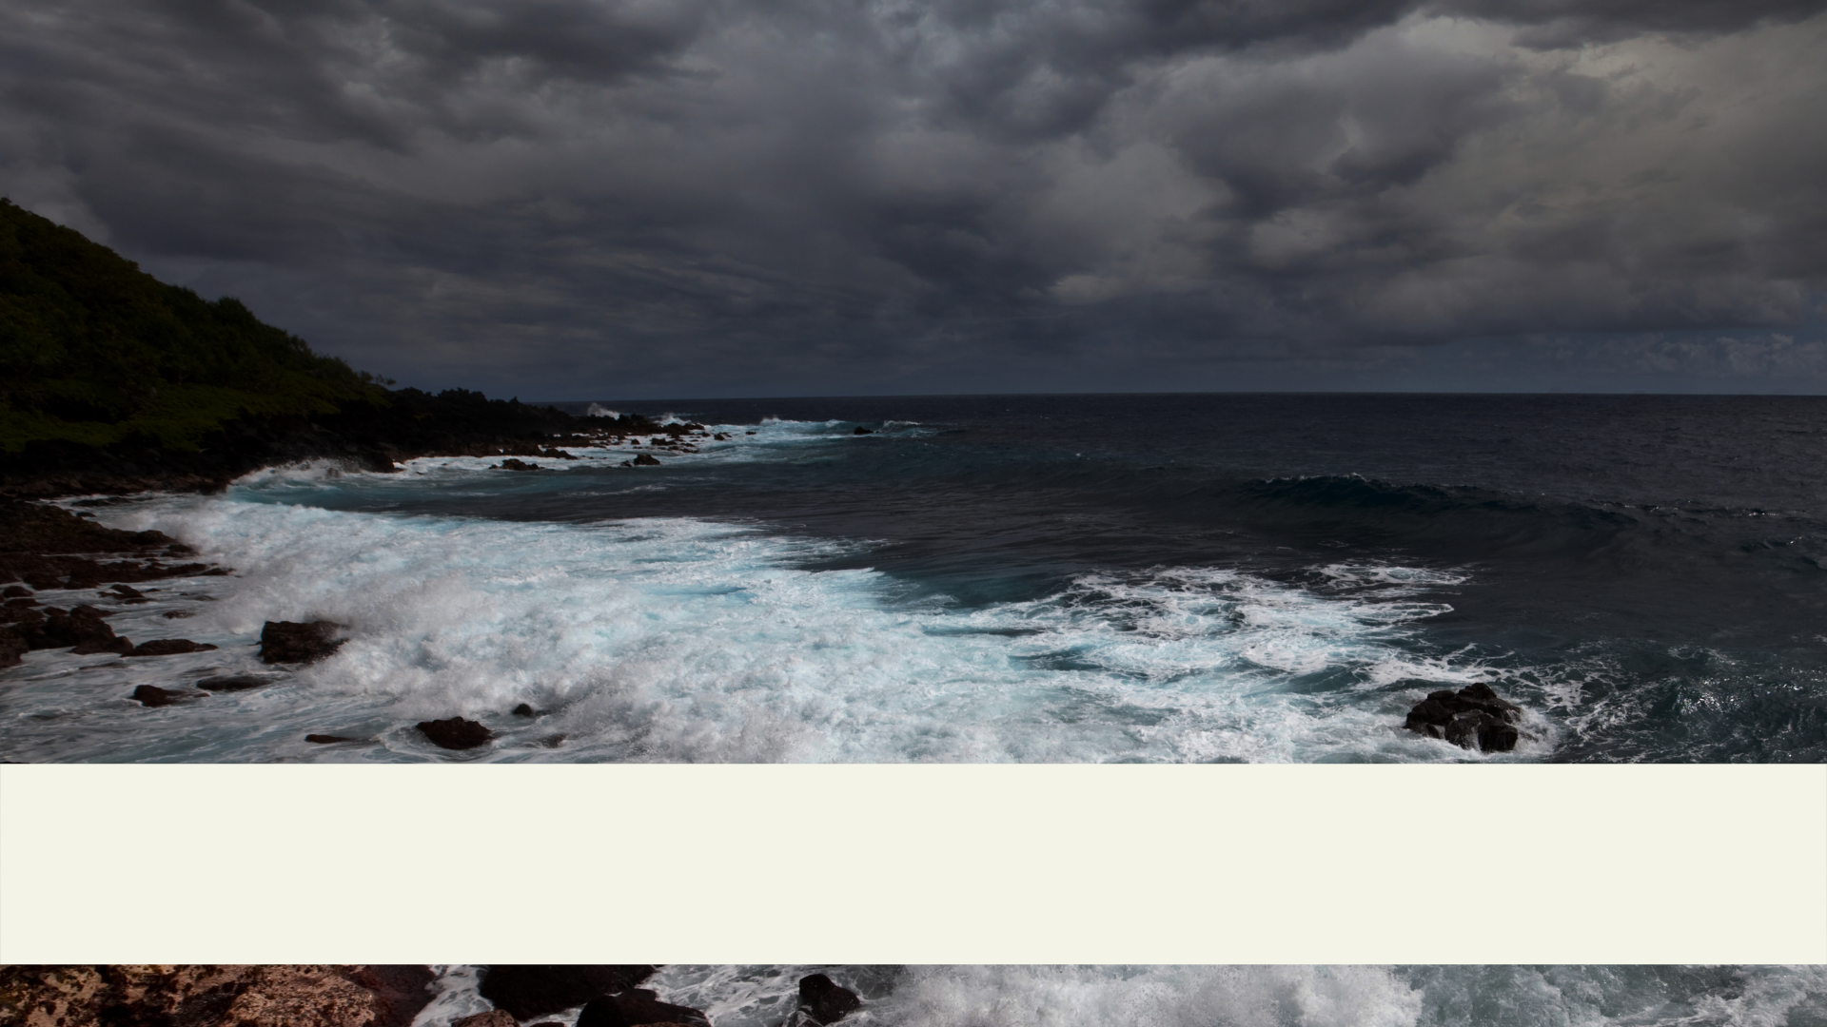
God’s Purposes In Our Suffering

Slide 20
John 16:33; Romans 5: 3-4; Job 23:10
Paul’s experience of suffering
We should expect trials in life
Why we face trials
— To build character
— To glorify God
— Discipline for known sin

Slide 21
John 16:33; Romans 5: 3-4; Job 23:10
— Test/build our faith
— Equipped to comfort others
— Help some to come to Christ
Sometimes beyond our understanding

Slide 22

What Is God Doing About Death and Suffering?

Slide 23
Hebrews 9:22; Romans 8:18
Jesus endured suffering on the cross on man’s behalf
— He paid the penalty for our sin
Jesus rose from the grave
— Eternal life for all who believe
— Ultimate power over death

Slide 24
Hebrews 9:22; Romans 8:18
Jesus sympathizes with our sorrows
— He Himself suffered
— He understands our suffering
Our suffering is limited

Slide 25

Our Source of Hope

Slide 26
Revelation 21:4; 1 Corinthians 15:21-22
The hope of resurrection
— This life is not the end
God has prepared an eternal home for believers
— Eternal life for all who believe
— We will spend eternity with Him

Slide 27
Revelation 21:4; 1 Corinthians 15:21-22
Our suffering will be over
The cross is the foundation for our hope and faith in enduring and overcoming trials
Victory over sin and death

