Slide 1


What Am I Supposed To Believe: Science or the Bible?
Dr. Heinz Lycklama
HeinzLycklama.com
heinz@osta.com

Slide 2
Science or the Bible?
You Can Trust the Bible
What About Science?
Four Questions
  Can Science Explain Everything?
  Origins: Creation or Evolution?
  Does Science Support Creation?
  Is First Life by Natural Processes Possible?
Conclusions
  Evolution is a Philosophy, Not Science
  You can Trust the Bible and Real Science
1 Pet. 3:15
Jude 3
2 Cor. 10:4-5
Col. 2:8
1 Th. 5:21-22

Slide 3

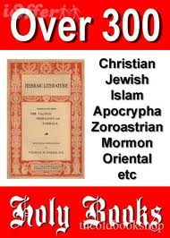
You Can Trust The Bible
Christian Faith Based on Bible
Bible Claims to be God’s Word
Skeptics Have Questions
Challenges to Our Faith
Using Critical Thinking Skills
Evidence for Truth
  Transmission of manuscripts
  Historical accuracy
  Prophecies fulfilled
  Science truths in the Bible
There Are Answers for Skeptics
2 Tim. 3:16,17
2 Pet. 1:21
Is. 55:8,9
1 Cor. 2:16

Slide 4

Challenges to Our Faith
Challenges as a believer and scientist
  Special and General Revelation
  Does what I believe to be true
  match reality?
Key challenges for our youth
  Indoctrinated in secularism/evolution
  No answers to the hard questions
Recent poll: >60% of youth
leave the church after leaving home
Lack of critical thinking skills

Slide 5
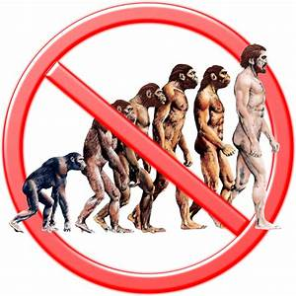
Reasons Youth Leave The Faith
Christianity is shallow and too exclusive
Church appears to be anti-science
Learning about evolution in college
Lack of specific or scientific
evidence for a creator
The teaching of secularism
and moral relativism
College is a hostile
environment towards Christianity
          Mike Riddle, Creation Training Initiative

Slide 6
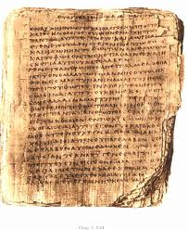
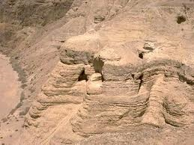
a. Reliable Transmission of the Bible
Reliability depends on:
  Number of copies of manuscripts
  Time gap, original to earliest copy
Dead Sea scrolls found 1947
  Earlier (by 1000+ yrs) copies of OT manuscripts
  Dated to 100-200 BC
Earliest NT manuscript
  Fragment of John’s gospel
  Dated to 125 AD
  Referenced by church fathers
99.99% of originals reclaimed

Slide 7
Manuscript Reliability
Work/Author | Date Written | Earliest Copy | Years Elapsed | Number of Copies
Caesar | 100-44 BC | 900 AD | 1000 | 10
Plato | 427-347 BC | 900 AD | 1300 | 7
Aristotle | 384-322 BC | 1100 AD | 1500 | 49
Iliad (Homer) | 900 BC | 400 BC | 500 | 643
Heridotus | 480-425 BC | 900 AD | 1300 | 8
New Testament | 40-95 AD | 125 AD | 30 | 25,000

Slide 8
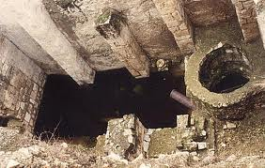
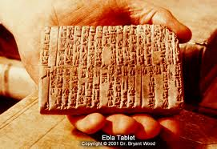
b. Historical Accuracy of the Bible
Gospel of Luke & Acts
  Written by Dr. Luke
  Eyewitness and Apostles reports
  32 countries, 54 cities, 9 islands
  Exact titles of historical figures
  Accurate history & geography
Ebla tablets found in 1974
  Confirm biblical places
  Confirm writing ability of Moses
Confirmed by archaeology
  Pool of Bethesda discovered
  Archaeologists use Bible as guide
Luke 1:1-4
Acts 1:1-2
John 5:2
Gen. 14:2

Slide 9
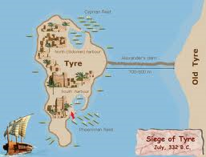
c. Fulfilled Prophecy of the Bible
27% of Bible prophetic (when written)
  500+ of 1000+ prophecies fulfilled
300 prophecies about Messiah
  109 fulfilled in His 1st Coming
  Birthplace, sold for 30 pieces
Prophecies about people, places
  Fall of Babylon, Jer. 50-51
  Destruction of Tyre, Ezek. 26
  Cyrus as ruler, Is. 44:28
Prophecies about Jews
  Dispersion and re-gathering
Is. 61:1-2, Luke 4:18-19a
  Dead Sea Scrolls
Mic. 5:2
Zech. 11:12
Jer. 50-51
Ezek. 26
Is. 44:28
Deut. 28:64
Is. 11:11-12
Is. 61:1-2
Luke 4:18-19

Slide 10
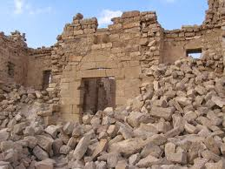
d. Biblical Truth in Science?
We trust the Bible for spiritual truth
Archaeology, history, geography,
and prophecy confirm the truth
of the Bible
Do we trust the Bible for truth in science?
  Astronomy, geophysics, geology, hydrology, meteorology, oceanography, physics, biology
There are many biblical references to
nature and natural processes
  Authors use everyday language
  Amazingly accurate statements
  Anticipatory scientific insights in the Bible

Slide 11
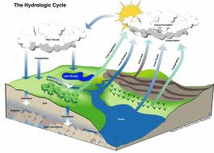
Scientific Accuracy of the Bible
Five categories: matter, space, time, force, action
Biblical references to science:
  Number of stars – 10**22
  Earth as a sphere
  Earth suspended in space
  Earth spinning on its axis
  Hydrologic cycle
  Life is in the blood
  Circumcision on day 8
Science disciplines established by Bible-believing scientists
Gen. 1:1
Acts 7:22
Jer. 33:22
Is 40:22
Job 26:7
Job 38:14
Eccl. 1:7
Lev. 17:11
Lev. 12:3

Slide 12
Scientific Disciplines Established by Bible-Believing Scientists
Discipline | Scientist
Astronomy | Johann Kepler (1571-1630)
Bacteriology | Louis Pasteur (1822-1895)
Chemistry | Robert Boyle (1627-1691)
Computer Science | Charles Babbage (1792-1871)
Dynamics | Isaac Newton (1642-1727)
Electrodynamics | Clerk Maxwell (1831-1879)

Slide 13
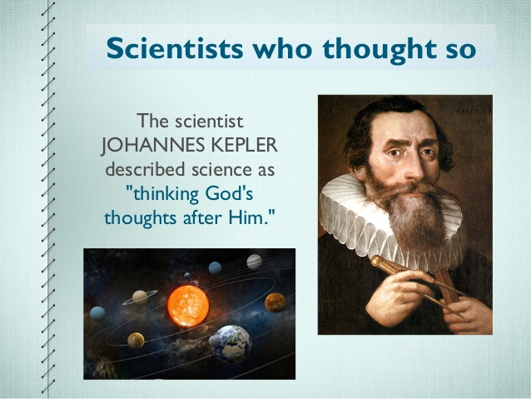
Kepler – Thinking God’s Thoughts …

Slide 14
Skeptics’ Claims Refuted
The Bible is NOT a book of myths
Gen. 1 and Gen. 2 are complementary
Isaiah written before prophecies were fulfilled – confirmed by Dead Sea Scrolls
Sodom and Gomorrah Existed - confirmed by the Ebla tablets
Moses could write first five books of the Bible – confirmed by Ebla tablets
Science statements in the Bible are TRUE
Evidence confirms the Bible (not just faith)

Slide 15

The Bible IS Trustworthy
Bible is a Book of Spiritual Truth
Accurately Copied Over Time
Confirmed by Archaeology,
History, Geography, Prophecy
Statements On Science Are True
The Bible IS God’s Word
There are answers to skeptics
Know What, Why, and How To
Defend What You Believe!
Know It! Live It! Share It! Defend It!
1 Pet. 3:15
Jude 3
2 Cor. 10:4-5
Col. 4:6
HeinzLycklama.com

Slide 16


What About Science?
Skeptics and unbelievers think:
  “The Bible is an antiquated religious
  book, filled with scientific fallacies
  and mistakes reflecting the naïve
  cosmology of the primitive tribes
  of the Near East.”
Even some professing Christians think:
  “The Bible is a book of true
  religion dealing solely with spiritual subjects and that, where it seems to touch on matters of science and history, it must be interpreted spiritually or allegorically,
  rather than literally.”
Evolution is Science
Creation is Religion

Slide 17

A War of Worldviews
Conflict between two worldviews
  Not between science and religion
  Between supernaturalism and naturalism
  Should God be banned from public life?
  Christianity has intellectual power
The question: Is Christianity true?
  Not – is it helpful?
  Does science fit into this?
  Does what I believe to be true
  match reality?
Science is a weapon in a larger cultural war

Slide 18
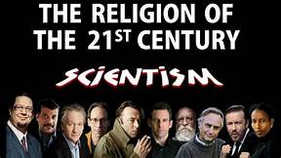
What Is Science?
“Science is the search for truth”
Science
  Systems of knowledge of
  the physical or material world
  based on facts obtained through observation and experimentation
Scientism
  The view that the hard
  sciences alone have the
  intellectual authority to
  give us knowledge or reality

Slide 19
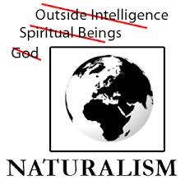
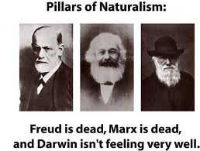
Naturalism (Scientism)
A belief denying that an event or object has a supernatural significance; specifically, the doctrine that scientific laws are adequate to account for all phenomena
“Even if all the data point to an intelligent designer, such an hypothesis is excluded from science because it is not naturalistic.”
Dr. Scott Todd, KS Univ. Immunologist

Slide 20

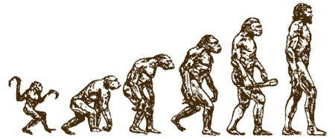
Present +
Repeatable +
Observable =
SCIENCE
Past +
Non-Repeatable +
Eyewitness Account =
HISTORY
Past +
Non-Repeatable +
No Eyewitnesses =
BELIEF

Slide 21
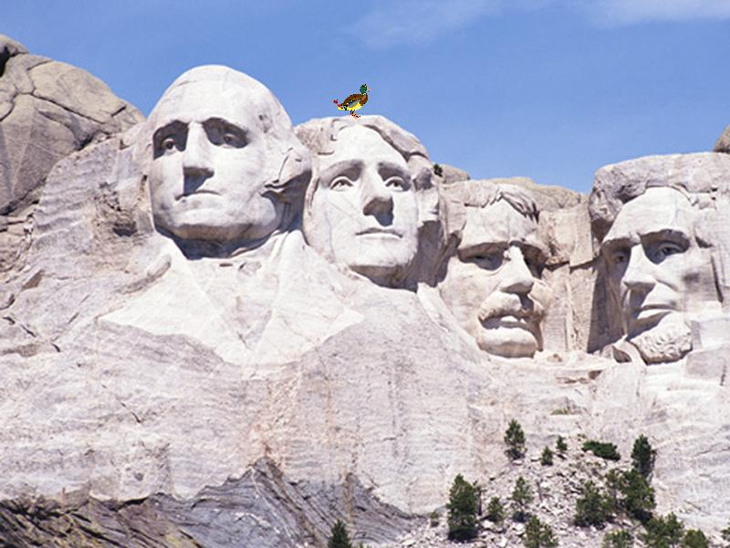
Chance, Necessity (Law) or Design?

Slide 22


1. Can Science Explain Everything?
“Operational” Science
  Postulate theory ->
  make observations ->
  prove/falsify theory
  Using the Scientific Method
“Origins” Science
  Were you there at the beginning?
  Can’t repeat the “experiment”
  “Forensic” science
  Model of science
  Which model best fits observed facts?

Slide 23
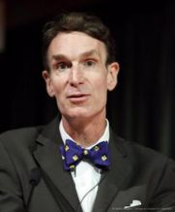
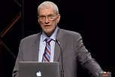
Bill Nye (“Science Guy”) Debates Ken Ham (AIG)
Public school textbooks are using the
same word science for observational
and historical science. They arbitrarily define science as naturalism and outlaw the supernatural. They present molecules-to-man evolution as fact. They are imposing the religion of naturalism/atheism on
generations of students.
Bill Nye
Ken Ham

Slide 24
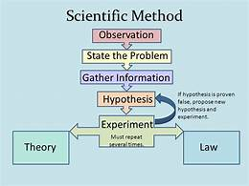
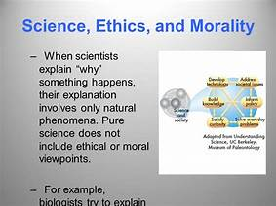
Scientific “Proofs”
What we can test scientifically
  Observable/repeatable processes
  Trends/tendencies in nature
  Processes/events that left evidence
What we cannot test scientifically
  Identity or motivation of
  who or whatever brought
  the universe into existence
  Historical events
  Ethics, morality
  Meaning, why?
  Consciousness, mind

Slide 25
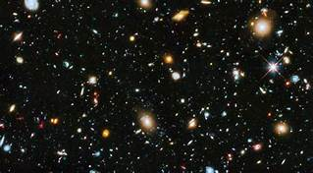
Origin of The Universe?
The universe had a beginning
The beginning of the
universe was caused
The cause was outside
the universe
The 2nd Law of Thermodynamics
  Useful energy running down
The universe is expanding
Something from nothing?
  No natural explanation
Really?

Slide 26
Origin of Laws of Nature?
Foundational/Fundamental laws
  Physics, chemistry, mathematics, logic
Scientific explanations
  Natural laws are supposed
Laws of nature in the Bible
  Law of cause and effect
  1st law of thermodynamics
  2nd Law of Thermodynamics
  Law of Biogenesis
Gen. 1:1
Gen. 1:31
Rom. 8:22
Gen. Chapter 1

Slide 27
Universe Fine-Tuned for Life
Force of gravity
Charge of the electron
Mass of proton
Nuclear force
Rate of universe expansion
Earth rotation of 24 hours
Level of oxygen in earth’s atmosphere
Earth, moon and sun distances
Hundreds of precise “dialed” physical constants

Slide 28
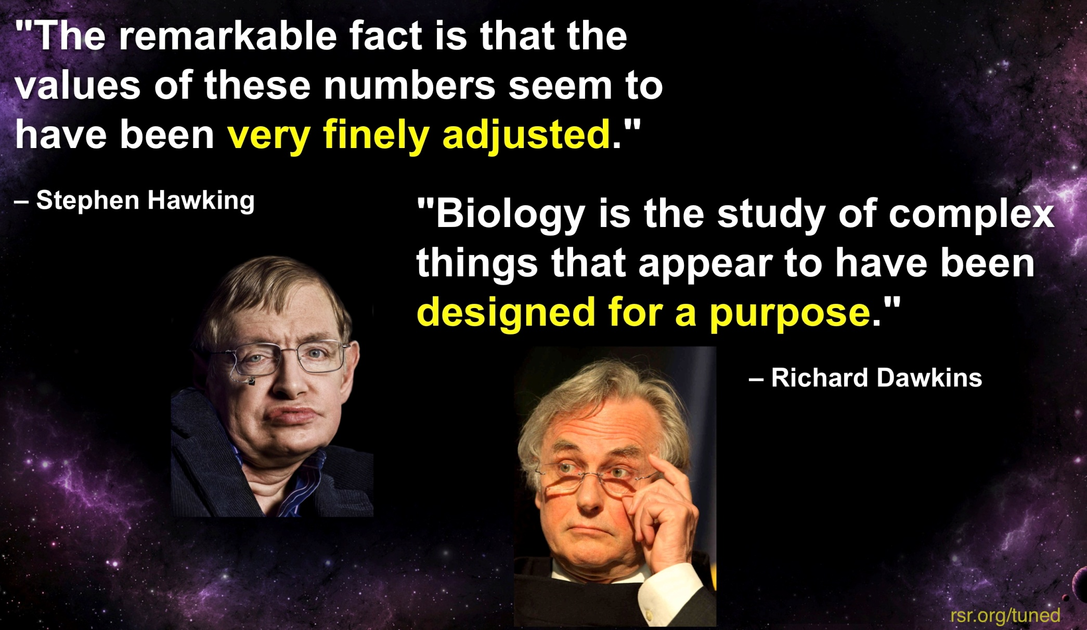
Do Atheists/Evolutionists Know The Truth?

Slide 29
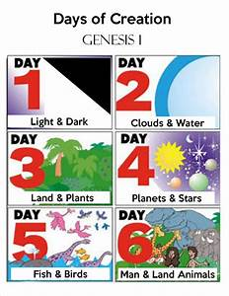

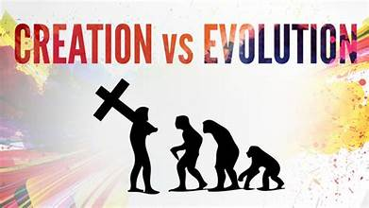
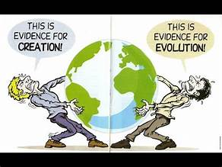
2. Origins: Creation or Evolution?

Slide 30
Model of Creation
The Bible is the inerrant Word of God
God is Creator
  Six days of Creation – Gen. 1:1 – 2:3; Ex. 20:11
  Creatures created/reproduce after their kind – Gen. 1 (10 x)
Man is created
  In God’s image – Gen. 1:26-27
Creation is dependent on God
Man is fallen and dependent on God
Creation and Science coherent and consistent
  God reveals Himself in Scripture (Special Revelation)
  God reveals Himself in nature (General Revelation)
Jesus and NT authors refer to Gen. 1-11 as history

Slide 31
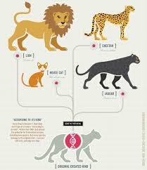
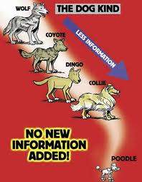
Creation of Distinct Kinds
Gen. 1: 11(1), 12(2), 21(2), 24(2), 25(3)
Ten major categories of organic life
created “after its kind”
  Plant kingdom - grass, herbs, fruit trees
  Animal kingdom - sea monsters, other marine animals, birds, beasts, cattle, crawling animals
  Man “kind”
One kind cannot transform
itself into another kind
  Definite and distinct categories
  There is variation within a kind
  These “kinds” still recognized today

Slide 32
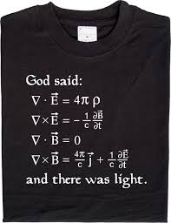

And God Said …
And God said:
  Gen. 1: 3, 6, 9, 11, 14, 20, 24, 26, 28, 29 (10x)
  e.g. “let there be light”, Gen. 1:3
And it was so:
  e.g. “and there was light”, Gen. 1:3
And God saw that it was good:
  e.g. “the light was good”, Gen. 1:4
Gen. 1:31, “…God saw everything
that He had made, and behold, it
was very good.”

Slide 33
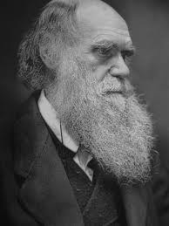
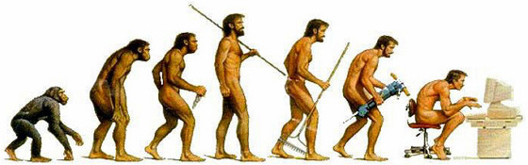
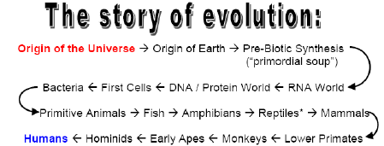
Model of Evolution
Claims about living organisms:
  Related through common ancestry
  Arose through mutations and natural selection by means of random chance processes of nature

Slide 34
The Meaning of Evolution
Arificial Selection
  Plant and animal breeding
Change
  Evolution of a coastline (random)
  Evolution of a car (designed)
Micro-Evolution [Adaptation]
  Small variation within prescribed limits of complexity
  e.g., finch beaks by mutation and natural selection
Macro-Evolution
  Particles -> people
Molecular Evolution
  Origin of life – assumes a mutating replicator
Only 1, 2 and 3
have been observed
4 never observed!
5 is impossible!

Slide 35
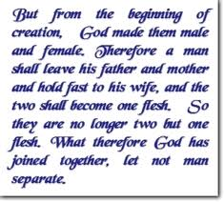
NT References to Gen. 1-11
Every NT writer refers to the
early chapters of Genesis
Jesus Christ referred to each of
the first 7 chapters of Genesis
  e.g. Mark 10:6-9 -> Gen. 1:27
Almost all NT books have references to Genesis 1-11, especially Gen. 1-2
Every chapter of Genesis 1-11 except chapter 8 is referred to somewhere in NT
Every NT writer accepted these early chapters as historically accurate

Slide 36
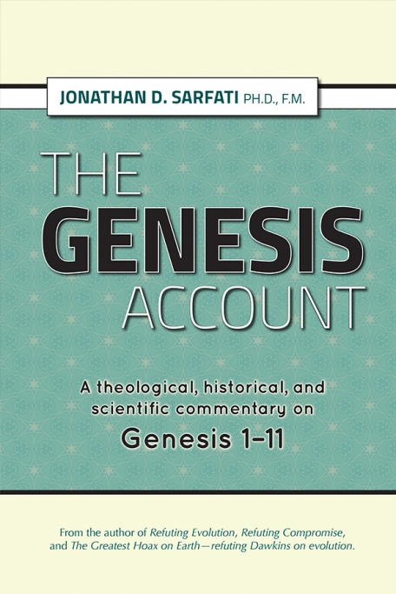
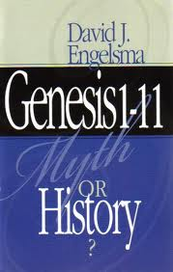
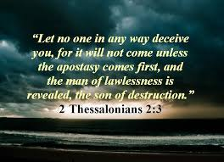
Removing Genesis 1-11
Removes true history
Removes the foundation
from all future history
Rejects the teachings of
Peter, Paul, other Biblical
writers, Christ Himself
  e.g. in the Gospels, Acts,
  Romans, Corinthian letters,
  Hebrews, Revelation
Eventually leads to apostasy

Slide 37


Debate on Atheism vs. Christianity, 1996?
“If there never was an Adam and Eve
there never was an original sin.
If there never was an original sin
there is no need of salvation.
If there is no need of salvation
there is no need of a savior.
And I submit that puts Jesus,
historical or otherwise,
into the ranks of the unemployed.
I think that evolution is absolutely
the death knell of Christianity.”
Frank Zindler,
Atheist
William Craig,
Apologist

Slide 38
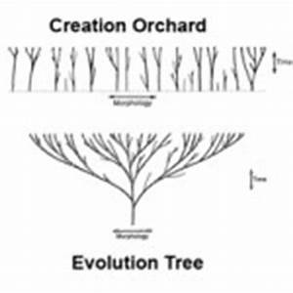
3. Does Science Support Creation?
Origin of man
Origin of the solar
system and planets
Origin of matter, energy
and natural law
Origin of first life
The fossil record
Mutations and natural selection
Teleology – evidence for design
Classification of biological organisms

Slide 39
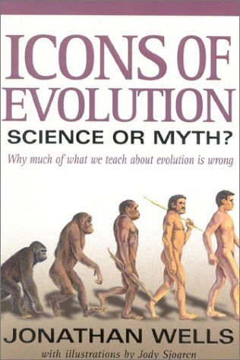
a. The Origin of Man
Evolution model predicts:
  Molecules -> man
  Man evolved from an
  ape-like ancestor
Creation model predicts:
  One human race, one blood
  Man’s appearance should remain largely the same

Slide 40
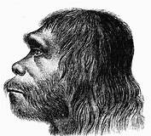
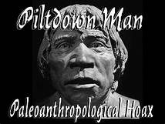
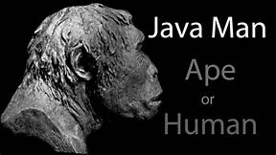
Famous “Hominid” Fossils
Neanderthal Man – 1856
Java Man – 1891
Piltdown Man – 1908
Nebraska Man – 1922
Ramapithecus – 1930
Lucy – 1974
Ida – 2009
Homo naledi - 2015

Slide 41

Lucy Debunked in 90 sec. (Genesis Apologetics)

Slide 42
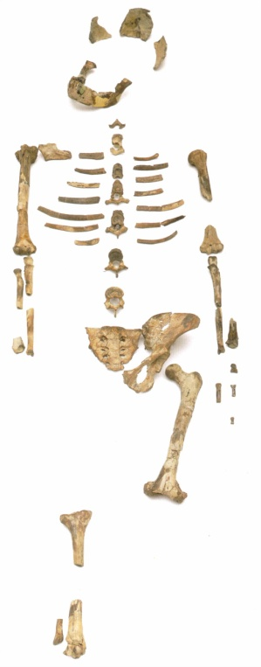
Summary of “Hominid” Fossils
Neanderthal – accepted as homo sapiens
Java Man – artificial construct
Piltdown Man
– proven to be a hoax
Nebraska Man
  an extinct pig
Ramapithecus
  an orangutan
Lucy – make-believe creature
40% skeleton
Museum
NO credible “ape-like -> human” fossil found!

Slide 43
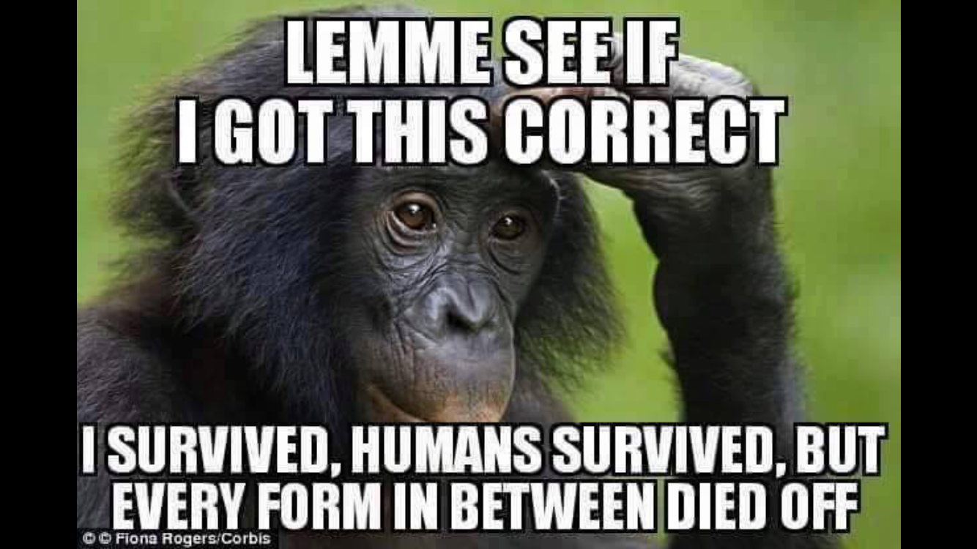

Slide 44
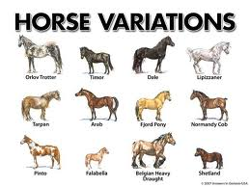
e. Classification Observations
What we do see is:
  Variations within kinds,
  e.g. varieties of cats, dogs,
  cows, horses, mankind
  No new kinds produced
  Some species become extinct
  Like begets like
  Cambrian fossils largely reflect
  today’s classification system
Observations consistent with Creation

Slide 45
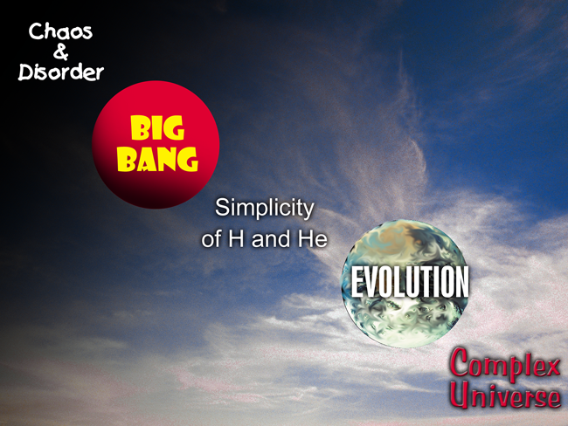
2nd Law of Thermodynamics
And Evolution
Notes:
ICR Image created by Lee Pierce & Beth Wiles

Slide 46
Fossil Record (Is Genesis History?)

Slide 47

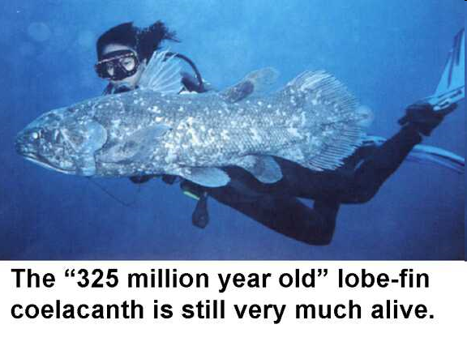
h. Fossil Record Summarized
“Living fossils” found
Sudden appearance of
fully formed fossils in
the “Cambrian Explosion”
“Kinds” still appear today
No new kinds evolved
Some species now extinct
Missing links are still missing
Supports the Creation Model!
1. Stasis
2. Sudden
Appearance

Slide 48
4. Did Life Originate From
Non-Life by Random Chance?
Origin of Life: God or Natural Processes?
  Viewing Life – Biblical and Evolution
  Chance, Necessity, or Design?
The Origin of Life by Natural Processes?
  Law of Biogenesis
  Forming Components of Life
  Law of Mathematical Probability
  Source of Information

Slide 49

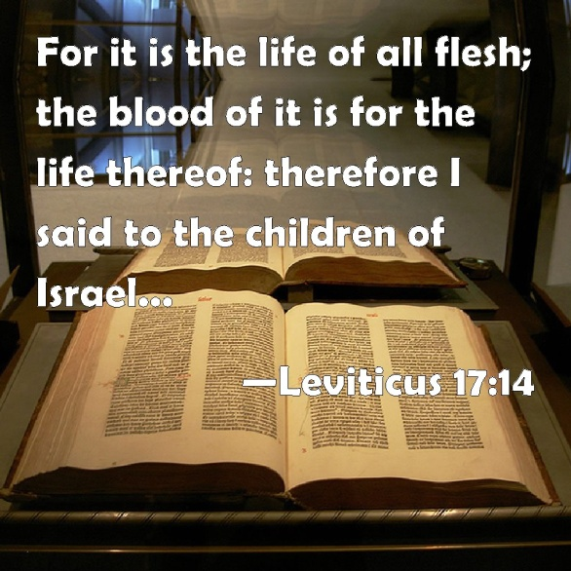
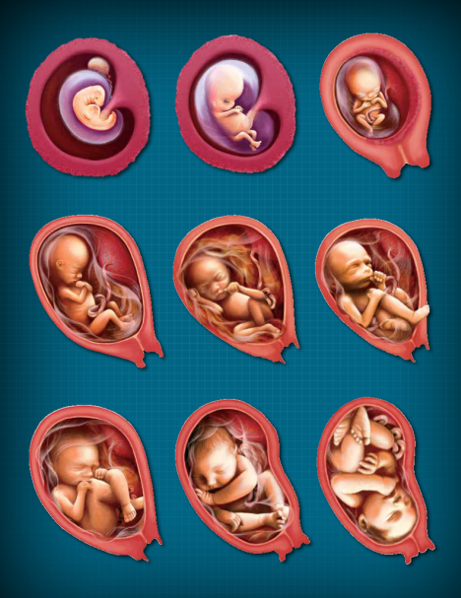

Biblical View of Life
Gen. 1:11-12, 21, 24-25, “…herb that
yields seed according to its kind, …,
beast of the earth according to its kind.”
  Indicates stability of different kinds
  Biogenesis, each producing after its
  own kind [used 10 times]

Slide 50
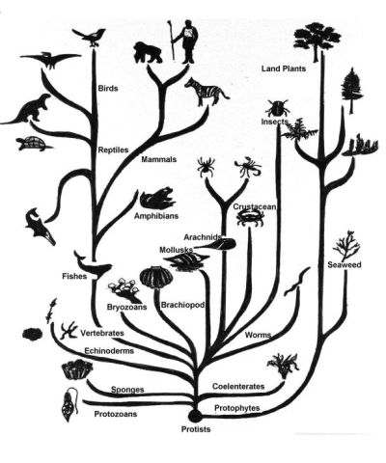
Evolution’s View of Life
  Related through common ancestry
  Arose through mutations and natural selection
  By random chance processes of nature
  Origin of first life from primordial soup?

Slide 51
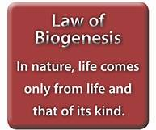
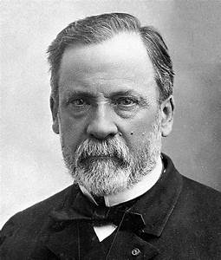
a. Law of Biogenesis
Spontaneous generation of life from non-life
  Greek philosophy of 2500 years ago
Abiogenesis experiments
  Redi in 1668, Spallanzani in 1750
  Virchow in 1858, Pasteur in 1864
  Law of Biogenesis established,
  and never falsified
Hypotheses proposed over last century
  Primordial soup, panspermia, etc.
  Miller’s experiment
  Abiogenesis hypothesis revived

Slide 52
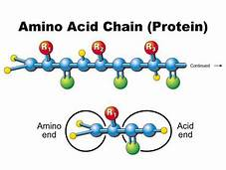

b. Forming Components of Life
Proteins – chain of amino acids
DNA (DeoxyriboNucleic Acid)
  Double helix
  Master genetic code
  Information for cell activities
RNA (RiboNucleic Acid)
  Single strand
  Protein building instructions
Catalysts for transcription
Replication
Cell membrane
“Chicken and egg” problem

Slide 53


1953 – Miller’s Experiment
Sparking gases to produce amino acids

Slide 54
A Self-Replicating Organism?
“Prebiotic soup is easy to obtain. We must next explain how a prebiotic soup of organic molecules, including amino acids and the organic constituents of nucleotides evolved into a self-replicating organism. While some suggestive evidence has been obtained, I must admit that attempts to reconstruct this evolutionary process are extremely tentative.”
[Dr. Leslie Orgel (evolutionist biochemist at the
Salk Institute, California), “Darwinism at the very
beginning of life,” New Scientist, 15 April 1982, p. 150]

Slide 55


c. Life From Non-Life
By Chance?
A single protein: 1 in 10²⁴⁰
  400 amino acids
A single cell: 1 in 10^{40,000}
  Spontaneous formation of life
Atoms in the universe: 10⁸⁰
Law of Probability: 1 in 10⁵⁰
  < 1 in 10⁵⁰ is mathematically impossible
Notes:
55

Slide 56


d. Life Requires Information
Evolution presupposition
  The universe consists of only two
  material entities – mass and energy
A 3rd non-material entity: information
Life consists of:
  Mass + energy (material)
  + information (non-material)
  Information is encoded in the DNA
  of all plant and animal cells
Information has four parts:
  Code, meaning, action, purpose

Slide 57


Information & Programs in the Cell
“Human DNA is like a computer
program but far, far more
advanced than any software
we’ve ever created.”
Bill Gates, Microsoft

Slide 58
DNA Is Code – Who Coded It?

Slide 59

Life Requires Information
Life = mass + energy (material)
+ information (non-material)
Life requires:
  Information stored in DNA
  Machines (storage + programming)
  Programs, e.g. replication
  Complexity: Irreducible (all parts)
  & Specified (meaning)
  Design requires an Intelligent Mind
Life from non-life? NOT by chance!
  Information IS the basis for life
  Information requires an Intelligent Mind

Slide 60



Life By Random Chance Processes Impossible
Law of Biogenesis never falsified
  Louis Pasteur experiment in 1864
Forming components of life
  Miller experiment failed
  Production in various environments fails
Mathematical probability of forming life by random chance processes is impossible – 1 in 10**40,000
  Probability of < 1 in 10**50 is impossible
Information (DNA) is the key to life
  Information requires an intelligent mind

Slide 61

Evolution’s Four Fatal Flaws
(Macro) Evolution Has Never Been Observed
NO Credible
Transitional Fossils
Life Can/Did Not Originate From Non-life By Natural Processes
Evolution Violates 2nd Law of Thermodynamics

Slide 62


Slide 63

Conclusions
You Can Trust The Bible
Life by Natural Processes
is Impossible
Science Supports Creation
Evolution is a Philosophy,
Not Science
You Can Trust Real Science
Man Created to Give God Glory, Rev. 4:11
Answers Available For Your Questions
Know! Live! Defend! Share! The Truth

Slide 64

Real Science
Finds God
Behind
Every Door
Evolution Is
Pseudoscience
Thank you for your attention!
Dr. Heinz Lycklama
heinz@osta.com
HeinzLycklama.com
Messages: Lectures & Sermons
ApologeticsForum.org
Helping Equip Believers in the Defense of The Faith

